Slide 1
Heineken
Income Statement

Slide 2
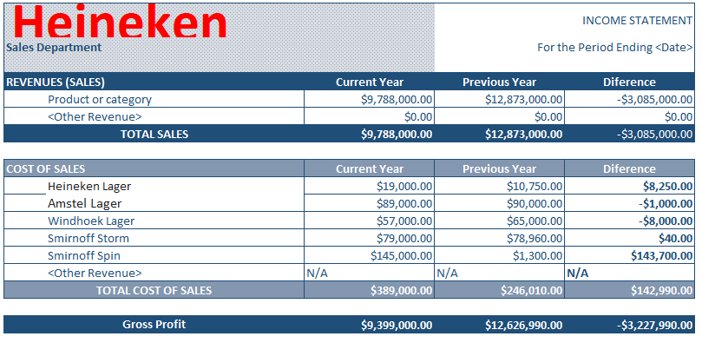

Slide 3
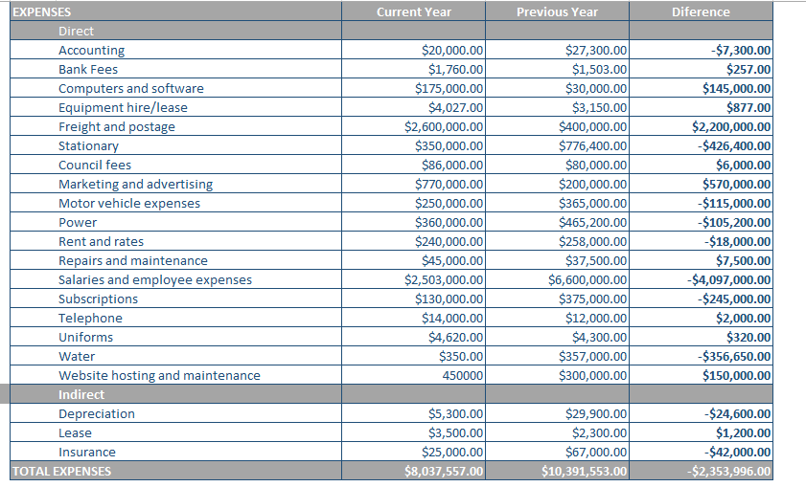

Slide 4
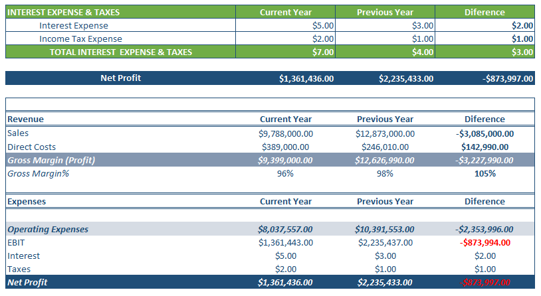

Slide 5
Direct Expenses
Selling/General/Admin = 7,500. The large allocation was accorded due to the need for attention to detail and compliance with government regulations.
Computers and software = 1,700,000. Most of the computers and software used in the previous year were still in good shape. A few upgrades were done.
Bank Fees = 1760. This expense many a times goes unnoticed, and is considered petty. Developments in online transactions could reduce this cost.
Equipment hire/lease = 4,027 The need for buying equipment rather than hiring came up.
Freight and postage = 2,600,000. The cost was high, but also signified an increase in exports
Repairs and maintenance = 45,000. Depicted the need to purchase new equipment.

Slide 6
Indirect Expenses
Depreciation = 3,194. The depreciation of beer was notably high, due to competition.
Lease = 2,961 Companies in foreign land were operating on leased properties.
Insurance = 2,500 There was a substantial decrease from previous year
Subscriptions = 128 There was a need for better advertisements, software and other billed services.
Shipping = 2,600 Closure of companies in the country led to increased shipping.

Slide 7
1.Way Forward
The company decided to introduce new products into the market. The decision was made from the realization that despite their challenges experienced in the 2020 financial year, such as restricted international trade, restrictions of movements and decrease in income, the Heineken products were still able to sell. It was also observed that the products had not reached the exponential level, hence further inputs would still make a good turn over.

Slide 8
Type of Analysis Used
Cost/Benefit Analysis
It is the process used to evaluate the benefits of a decision making process against the costs resulting from the action. It is imperative to study other company’s actions and the associated results. A case study and past experience would serve a good guide towards the decision making point.

Slide 9
2. Financial Factors
Inflation
Recession
Interest Rates
Demand and supply
Tax

Slide 10
3.Non Financial Factors
Diversity
Management Structures
Growth potential
Social Environment (Education, labor and culture)

